Slide 1
Using Statistical Modeling Methods in a Dataset with High Multicollinearity
Group Project
Seyedeh Shaghayegh Rabbanian
Saber Nemati
Advanced Topics in Statistical Modeling (EXST 7152)
Spring 2021

Slide 2
Dataset Information
Application: Gas Turbine (GT) propulsion plant of a naval vessel
Based on simulation
Output: compressor decay state (decaystate)
No. of Predictors: 16
Lever position (lp) / Ship speed (v) / Gas Turbine shaft torque (GTT) / GT rate of revolution (GTn) / Gas Generator rate of revolutions (GGn) / Starboard Propeller Torque (Ts) / Port Propeller Torque (Tp) / High Pressure Turbine exit temperature (T48) / GT Compressor inlet air temperature (T1) / GT Compressor outlet air temperature (T2) / HP Turbine exit pressure (P48) / GT Compressor inlet air pressure (P1) / GT Compressor outlet air pressure (P2) / GT exhaust gas pressure (Pexh) / Turbine Injection Control (TIC) / Fuel flow (mf)
License: A. Coraddu, L. Oneto, A. Ghio, S. Savio, D. Anguita, M. Figari, Machine Learning Approaches for Improving Condition-Based Maintenance of Naval Propulsion Plants, Journal of Engineering for the Maritime Environment, 2014, DOI: 10.1177/1475090214540874, (In Press)

Slide 3

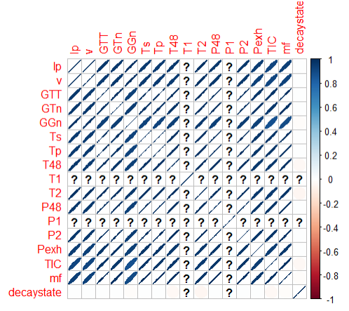
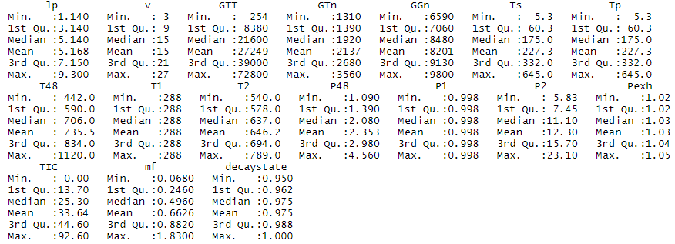
Exploratory Data Analysis

Slide 4
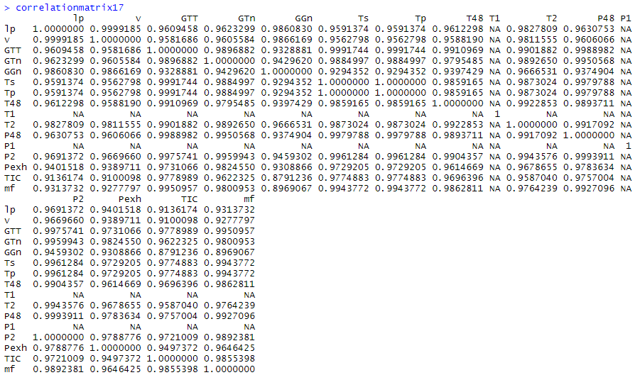
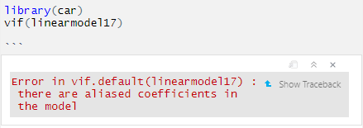
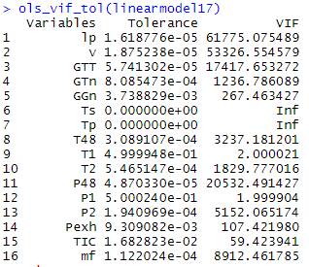
Exploratory Data Analysis

Slide 5
Exploratory Data Analysis
Three types of dataset:
cbm17: Includes all the predictors (No. of predictors: 16)
cbm15: T1 and P1 (which are constant variables) are removed. (No. of predictors: 14)
cbm14: Tp (which is identical to Ts) is removed. (No. of predictors: 13)

Slide 6
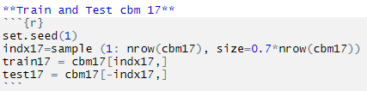
Predictive Modeling
Multiple Linear Regression (LM)
OLS
Best Subset Selection
Shrinkage methods (Ridge, Lasso, ElasticNet)
Regression Tree
Full tree (unpruned tree)
Pruned tree
Modeling Goal:
The overall goal of this team project is to present predicting model for estimating the compressor decay state
Comparing different predictive models.
Training and Test set:
70% training
30% test

Slide 7
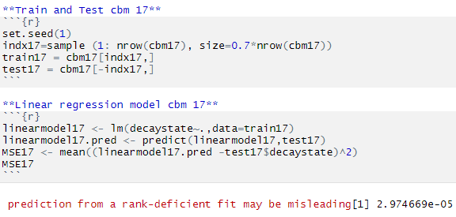
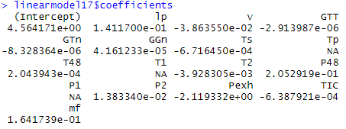
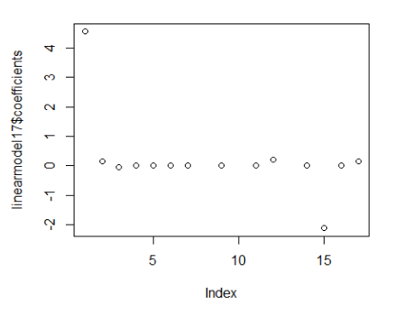

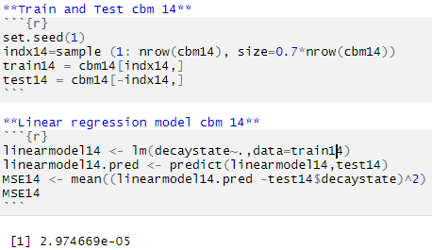
Ordinary Least Square (OLS)
For cases cbm17 and cbm15, there is a warning about the misleading prediction.
However, in all cases the calculated MSE is the same.

Slide 8
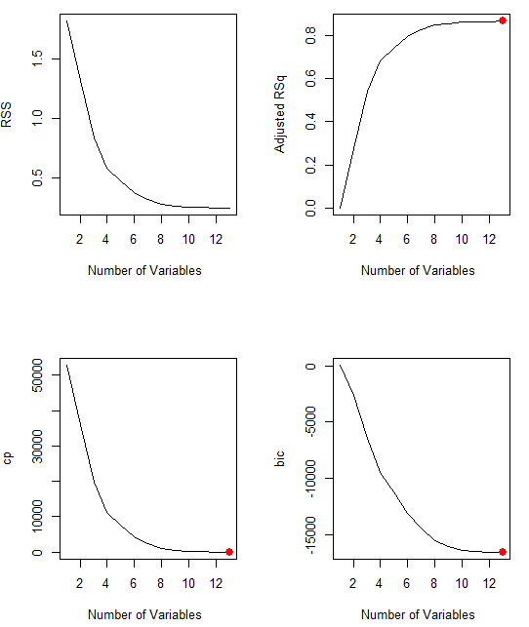
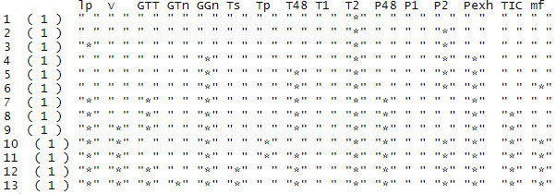
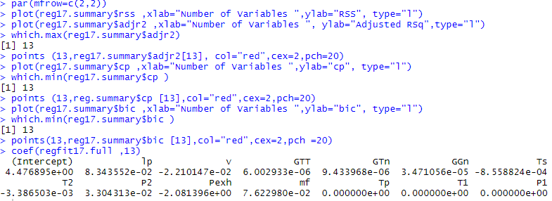
Best subset selection- 17 - RSS, Adjusted Rsq, cp , bic

Slide 9
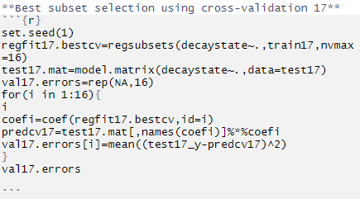

Best subset selection- 17 –cross validation
Lowest MSE with 13 predictors → The model tends to be DENSE.

Slide 10
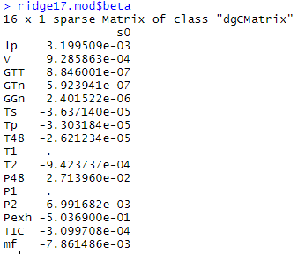
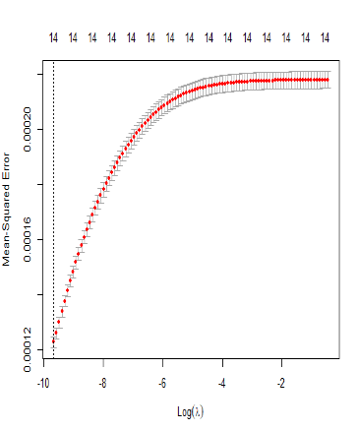

Ridge - cbm17
Coefficients of Ts and Tp are almost the same.
14 predictors selected.
No significant difference in β values for cbm15 and cbm14.

Slide 11
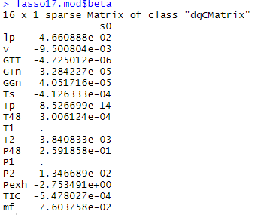
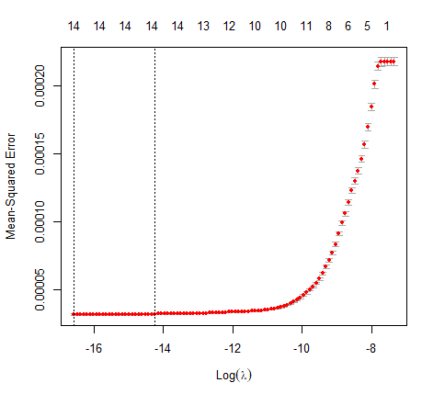

LASSO - cbm17
Coefficient of Ts is almost zero.
13 predictors selected.
No significant difference in β values for cbm15 and cbm14.

Slide 12
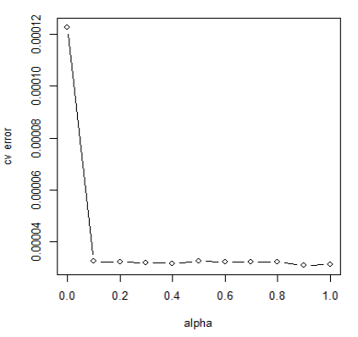
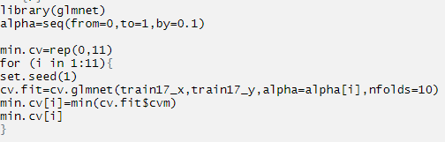

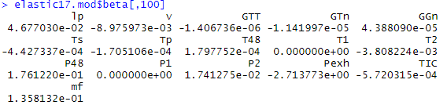
ElasticNet - cbm17
Performance very similar to Ridge.
14 predictors selected.

Slide 13

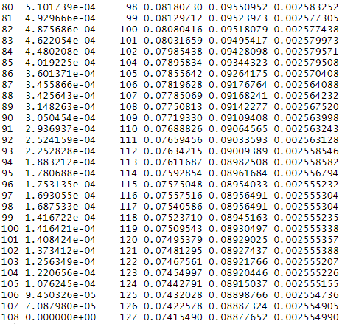
Classification and Regression Trees (CART)
xerror_min = 0.08877652
xstd = 0.002554990
1-SE rule: xerror = 0.08877652 + 0.002554990 = 0.09133151
Best tree: splits = 109, leaves = 90

Slide 14
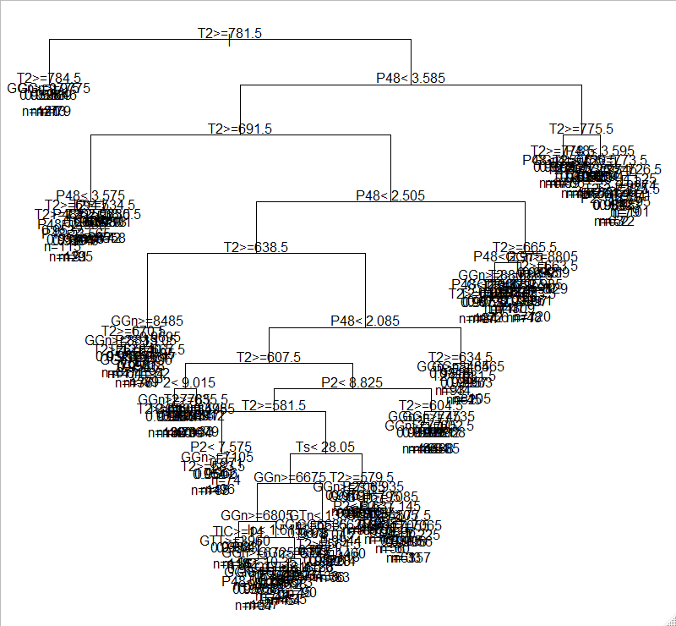

Classification and Regression Trees (CART)

Slide 15
Comparison
Method | MSE
OLS | 2.97e-05
Best Subset | 3.78e-05
Ridge | 1.22e-04
Lasso | 3.09e-05
ElasticNet | 3.11e-05
CART | 1.94e-05
CART has slightly better performance than other methods.

Slide 16
Thank you!

